Slide 1
MMA 801 – Introduction to Management Session One – In-Class Assignment 1 What is Strategy? “Disney +” Living Case
Master of Management in Analytics May 12, 2020 Stirling Team

Slide 2
Part 1 – WHAT IS Strategy?
MMA 801 – Introduction to Management

Slide 3
What is Strategy?
What is Strategy?
Set of directives/activities that incorporates the mission and vision of the company based on market information that is actionable and measurable
Focused and specific, requires trade off in competing
Subject to review based on market changes
The Purpose of the Strategy:
Create unique market position that is sustainable as a competitive advantage
Should yield value generation

Slide 4
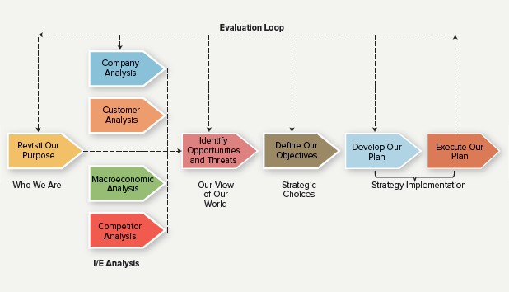
Pre-Strategy Planning Process
Revisit our mission/vision
Assess the landscape and market
External analysis
Internal analysis
Identify strength and weakness
Definite Strategy
Develop action plan
Business: Strategy, Development, Application, 2e, Bissonette, McGraw-Hill Ryerson, Publishers, 2016

Slide 5
Part 2 – Disney + Living case
MMA 801 – Introduction to Management

Slide 6
Situation
What is the situation which Disney finds itself at this particular strategic pivot point?
Recently launched and became a major player in the streaming platform market
High expense to be sustainable (large production cost); might not generate healthy ROI
Market is very competitive
Difficult to increase customer base

Slide 7
Complication
The complication and/or challenge at hand which Disney must respond to
Increase in competition in a saturated, price sensitive market
Strategy: Challenge to identify specific market segment
Executive: Lack of technological depth
Complication between customers and consumers

Slide 8
Critical Questions
Should Disney be satisfied as a premium content provider or vertically integrated entertainment portal?
How do you evolve revenue model factoring in the cost of content production to make sure it is sustainable?
How does Disney leverage their customer data to enhance their recommendation system?
How can they improve technological depth?
What is the target market segment?

Slide 9
Recommendations
Develop data strategy to re-assess the customer market segment
- Build up technological team and infrastructure
- Analyze consumer data, focusing on the mismatch of target consumer and customer data after launch to understand what are the gaps
Create customer profile and cluster analysis
Offer accurate movie/recommendation system to viewer that have a click rate of at least 60%+
Use the data to calculate estimated customer churning to forecast long term revenue generation
Create the right content for the target market (e.g. Young adults, Kids)
Explore the creation of entertainment ecosystem
Redefine the movie experience

